Slide 1
E5IoT Project
Boiler-error IFTTT interface

Slide 2

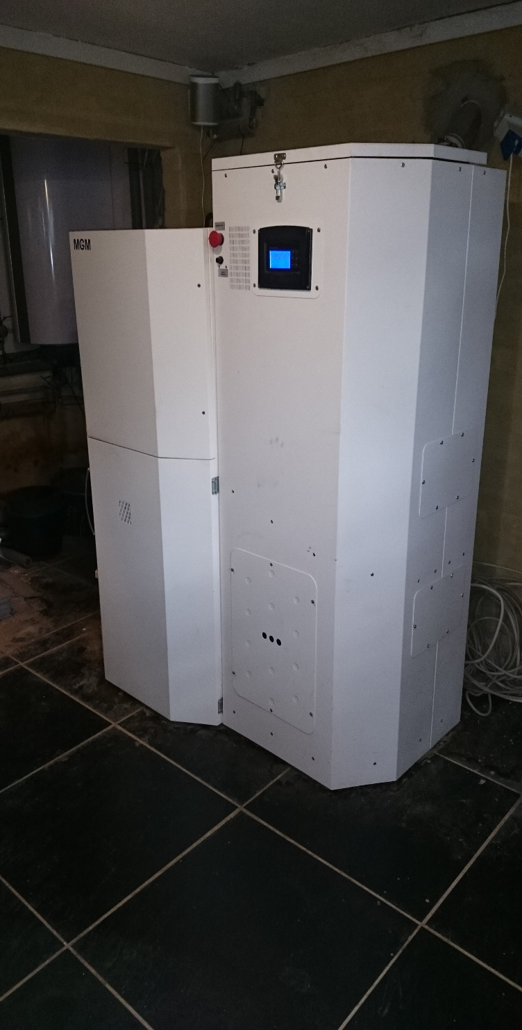
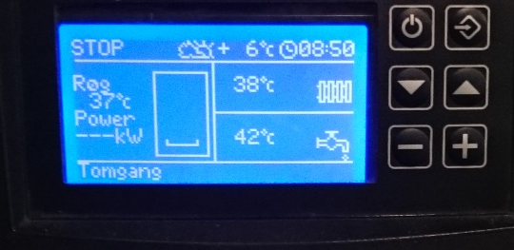
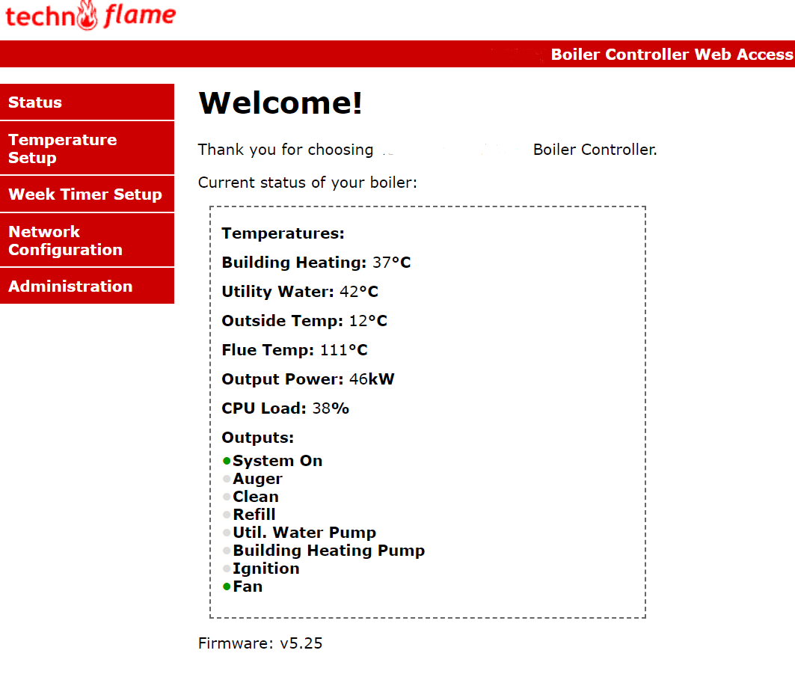
Project precursor
Wood-pellet boiler
Used for house and utiliy water heating
When error occurs, house heating is no longer
effective after 15 minutes. Up to 160 liters of hot water is
stored in utility tank, which can last between 2-24h
if full.
LCD interface
Web interface
On error - both interfaces show an error, and a low
buzzer-alarm in the boiler is activated

Slide 3
Problem overview
Boiler is located in basement, so there is no frequent supervision of boiler – in the future boiler will be moved to an entirely different building making supervision even more infrequent.
LCD and web interfaces also require manual monitoring to detect error
Boiler-rooms to have to comply with building regulations, as a consequence, sound is heavily dampened rendering buzzer useless as error detection.

Slide 4
System requirements
Make error detection immediate (sensor)
Make error detection distractive, but not intrussive for users
Distinguish between error types
Rutine errors – out of pellets, ignition error
Critical errors – backburn, overheating (overtemperature), overcurrent
Integrate error notification into existing smarthome environment (actuator)

Slide 5
Project feasibility study
Is it possible to extract necessary data from platform?
Buzzer alarm
This signal could easily be used as a flag for the particle to signal an error, but is unable to provide any information regarding error type.
LCD decoder
Reverse-decode signals sent to LCD, and compare to known error strings

Slide 6
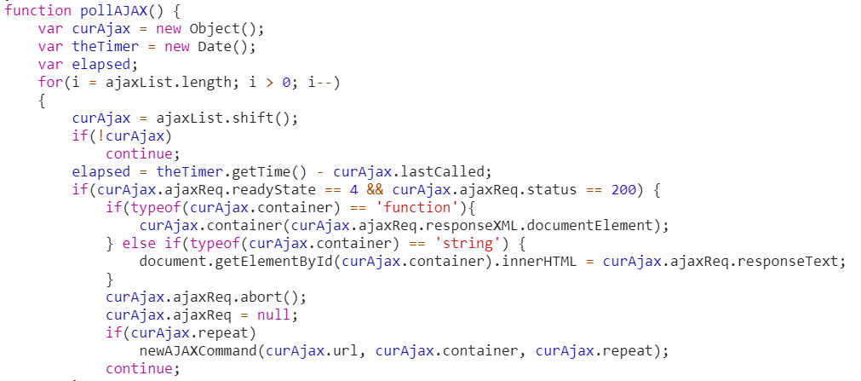
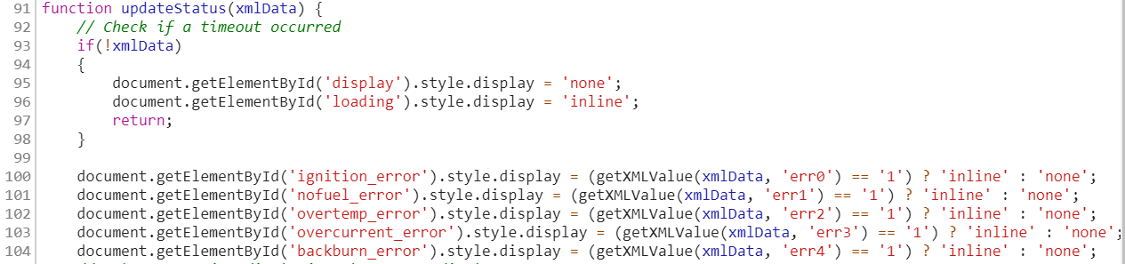
Project feasibility study
Is it possible to extract necessary data from platform?
Web server data retrieval
Ajax protocol parsing
When inspecting the code running on the
webserver, it showed an Ajax protocol is
used to retrieve data from an XML document.
Not being familiar with the Ajax protocol
this option was dismissed after several
attempts due to time-constraints.
Further inspection into some of the
references made in the initial code
showed how the values on the web
server main page are updated

Slide 7
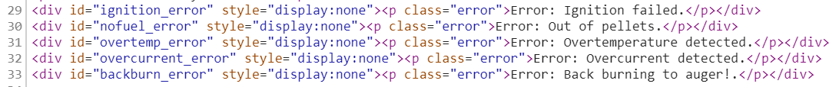
Project feasibility study
Is it possible to extract necessary data from platform?
Error parsing
The Ajax protocol parsing functions, while not being able to extract data, did show how the error codes should be parsed to make them human-understandable
This showed how the error numbers codes are translated

Slide 8
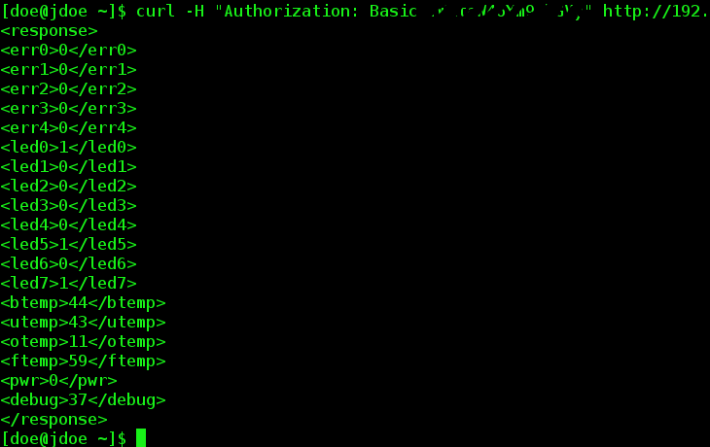

Project feasibility study
Is it possible to extract necessary data from platform?
Having identified the errors, a given error could be provoked and the dataflow monitored to show where the error data was originating – this was traced to a file with the necessary data content.
Note ”err1” flag

Slide 9
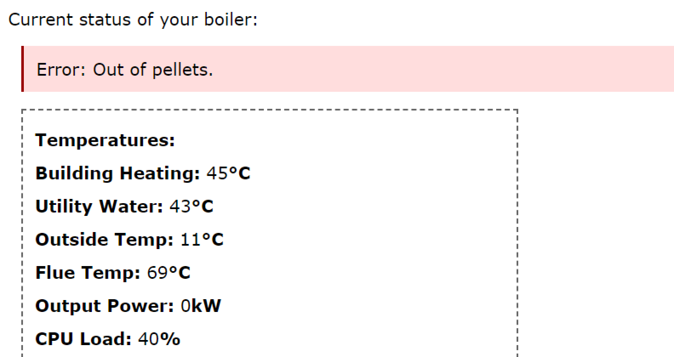
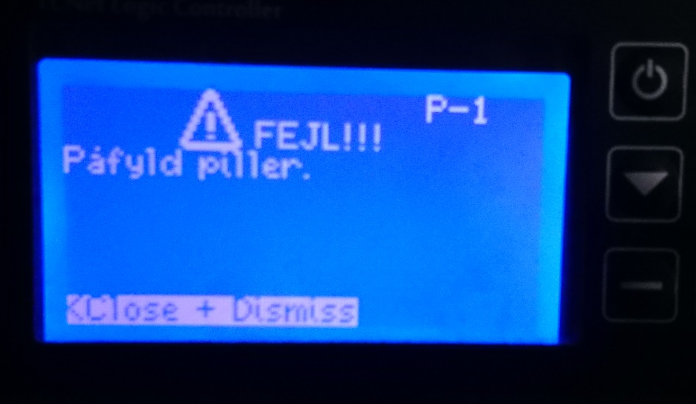
Project feasibility study
Is it possible to extract necessary data from platform?
Indeed the error given was verified both on the LCD and the web platform

Slide 10
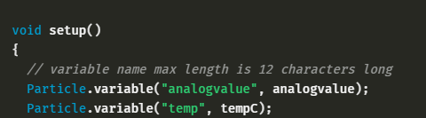
Project development
Create Github Repo - done
Create project in BB -
Using HTTPClient library to authenticate and get access to password protected webserver - done
HTTPClient also enables data retrieval – To do
Using particle.variable functions this data can be pushed to IFTTT Cloud – To do
IFTTT integration with Philips Hue bulbs and phone notification to provide user error-alerts – Needs analysis

